Slide 1
Hofstede’s Six Cultural Dimensions
Based on Geert Hofstede’s dimensions of national culture: https://hi.hofstede-insights.com/national-culture

Slide 2
Hofstede’s Six Cultural Dimensions
As we go through the continua on each slide, take some time to consider where you might fall o. Consider your cultural values and behaviors related to the society in which you live, or in which you grew up. You can choose to think of society on a national, regional, or local level.
Note: Where you fall on the continua is not necessarily static. You may fall at different points depending on the context and situation. For example, you might prefer consensus in your personal life, but your work environment might be more competitive.

Slide 3
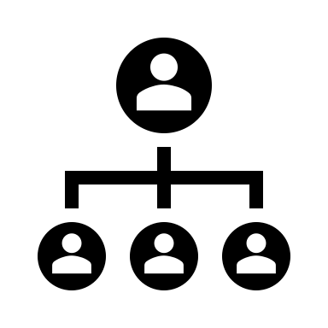
Power Distance
The fundamental issue here is how society handles inequalities among people.
More comfortable with hierarchy.
More comfortable with equal distribution of power.
Large Power Distance
Small Power Distance

Slide 4
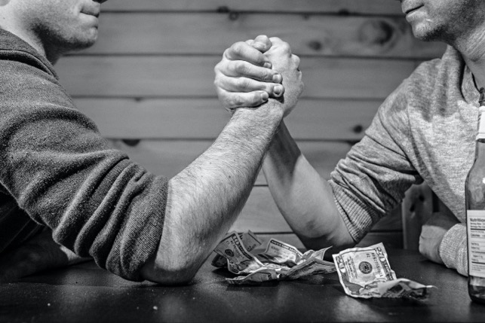
Masculinity vs. Femininity
The fundamental issue is whether society is more competitive or more consensus oriented.
Competition is valued.
Consensus is valued.
“Traditionally” Masculine
“Traditionally” Feminine

Slide 5
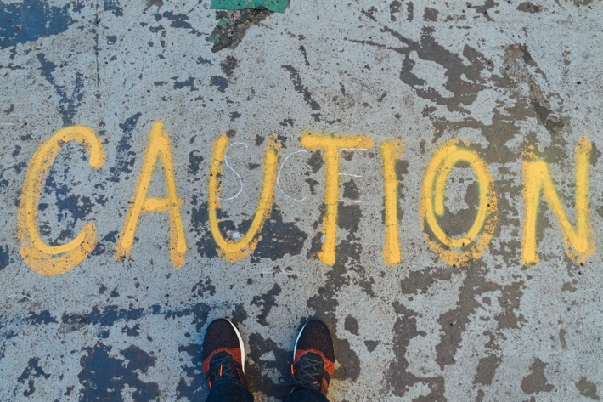
Uncertainty avoidance
The fundamental issue here is how a society deals with the fact that the future can never be known: should we try to control the future or just let it happen?
Uncomfortable with ambiguity.
Ambiguity is welcomed.
Strong
Weak

Slide 6
Individualism vs. Collectivism
The fundamental issue is whether people’s self-image is defined in terms of “I” or “we.”
The individual is emphasized over community.
The community is emphasized over the individual.
Individualism
Collectivism

Slide 7
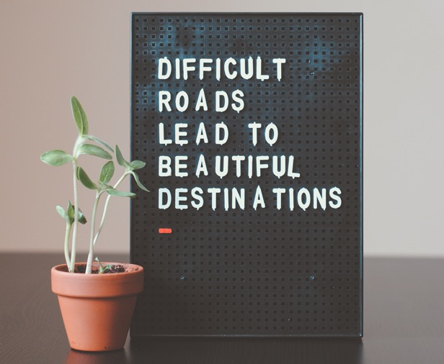
Long-term vs. short-term Orientation
The fundamental issue is whether society is more focused on future rewards or quick results.
Wide focus that includes past, present, and future.
More focused on the present.
Long-Term Orientation
Short-Term Orientation

Slide 8
Indulgence vs. Restraint
The fundamental issue here is the extent to which people try to control their desires and impulses.
Restrain your desires and stick to social norms.
Indulge your desires and have fun.
Indulgence
Restraint

Slide 9
Debrief questions
Where would you place yourself on these various continua? Why?
Do you people in your cultural group generally agree with you?
How much variation exists within your cultural group?
Did you identify any instances where it might depend on the situation or context?
What stereotypes or preconceived notions do you often have about people on different points on these continua?
What stereotypes or preconceived notions might people have about you depending on where you fall on these continua?
What are some strategies you might use to better understand or relate to people who fall on different points than you?

